Slide 1

Institute of Engineering & Technology

Slide 2
PROJECT: CHAZON ( A REAL-TIME CHAT APPLICATION)
Presented by:
201500112 ANSHIKA GUPTA
201500830 YASHKANT BAJPAI

Slide 3
CONTENTS
INTRODUCTION
OBJECTIVE
TECHNOLOGIES AND DESCRIPTION
FRONT END AND BACK END
DFD
SCREENSHOTS
CONCLUSION
FUTURE REFERENCES

Slide 4
INTRODUCTION
Our project is an example of a virtual learning platform.
It majorly consist of front-end development functionalities along with some backend ones such that sign in/out etc.
Long-term goal: E-Learning Portal is used to provide a virtual platform for quality education and interesting supportive practices.

Slide 5
OBJECTIVE
The purpose of developing this website is to make quality educational content available virtually, with the platform having quizzes and support modules embedded.
Another purpose is to reach out to students to provide a virtual platform for learning with fun.

Slide 6
TECHNOLOGIES AND DESCRIPTION
The base technology used is based on HTML, CSS, JS, PHP and Xampp Application.
The combination allows us to easily construct a three-tier architecture (front end, back end, database) entirely.

Slide 7
HTML — defines the structure of the page
CSS — used for designing formatting of the web pages
JS — scripting language used to enhance the functionality of the browser
PHP — scripting language for making dynamic and interactive web pages.
Xampp — software distribution which provides the Apache web server, MySQL database, php and perl all in one package.

Slide 8
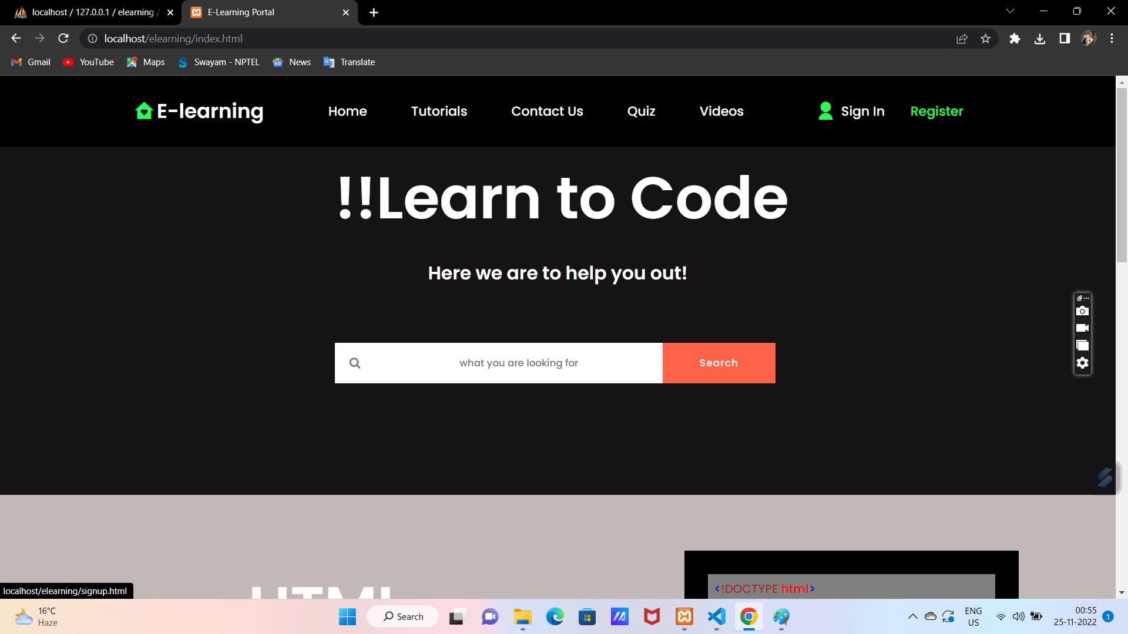
PROJECT VISUALIZATION
FRONT END :
HOME PAGE :

Slide 9
REGISTER PAGE Here user enter all the detail according to the registration page user must enter the valid email ID Fields to mention : - First Name - Last Name - Mobile - Email - Password

Slide 10
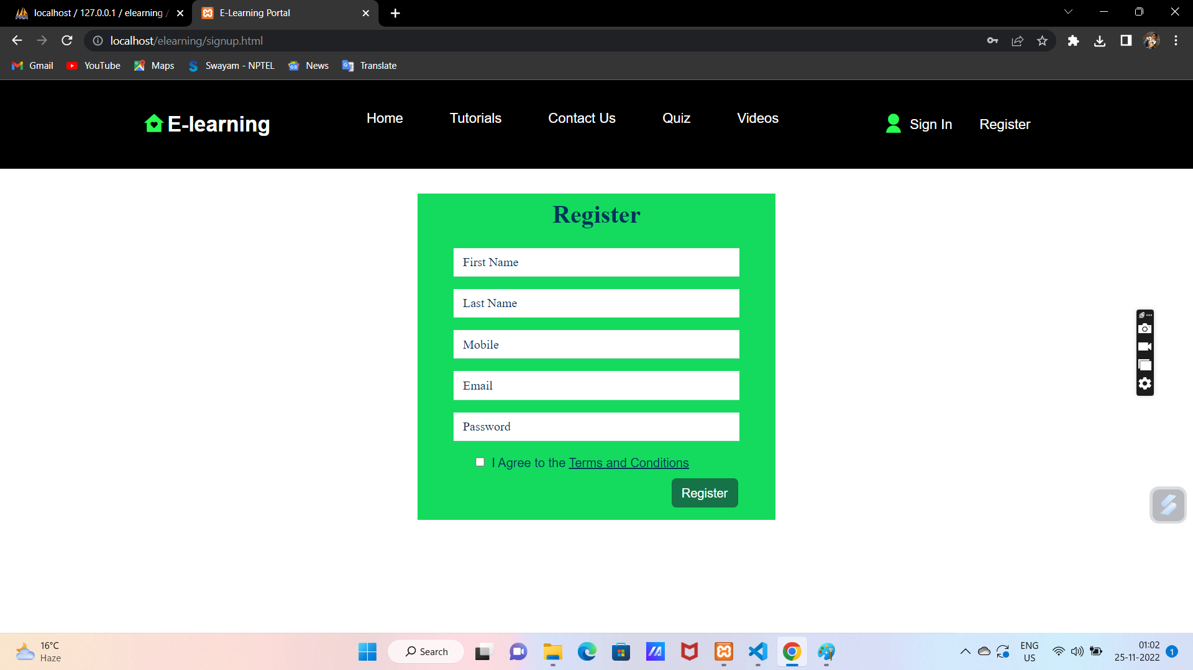
REGISTER :

Slide 11
LOGIN PAGE : *Enter the valid email and password then click on the login button * If the user is not registered then click on create one for a new account. Notifications will announce themselves if the username or password doesn’t match accordingly.

Slide 12
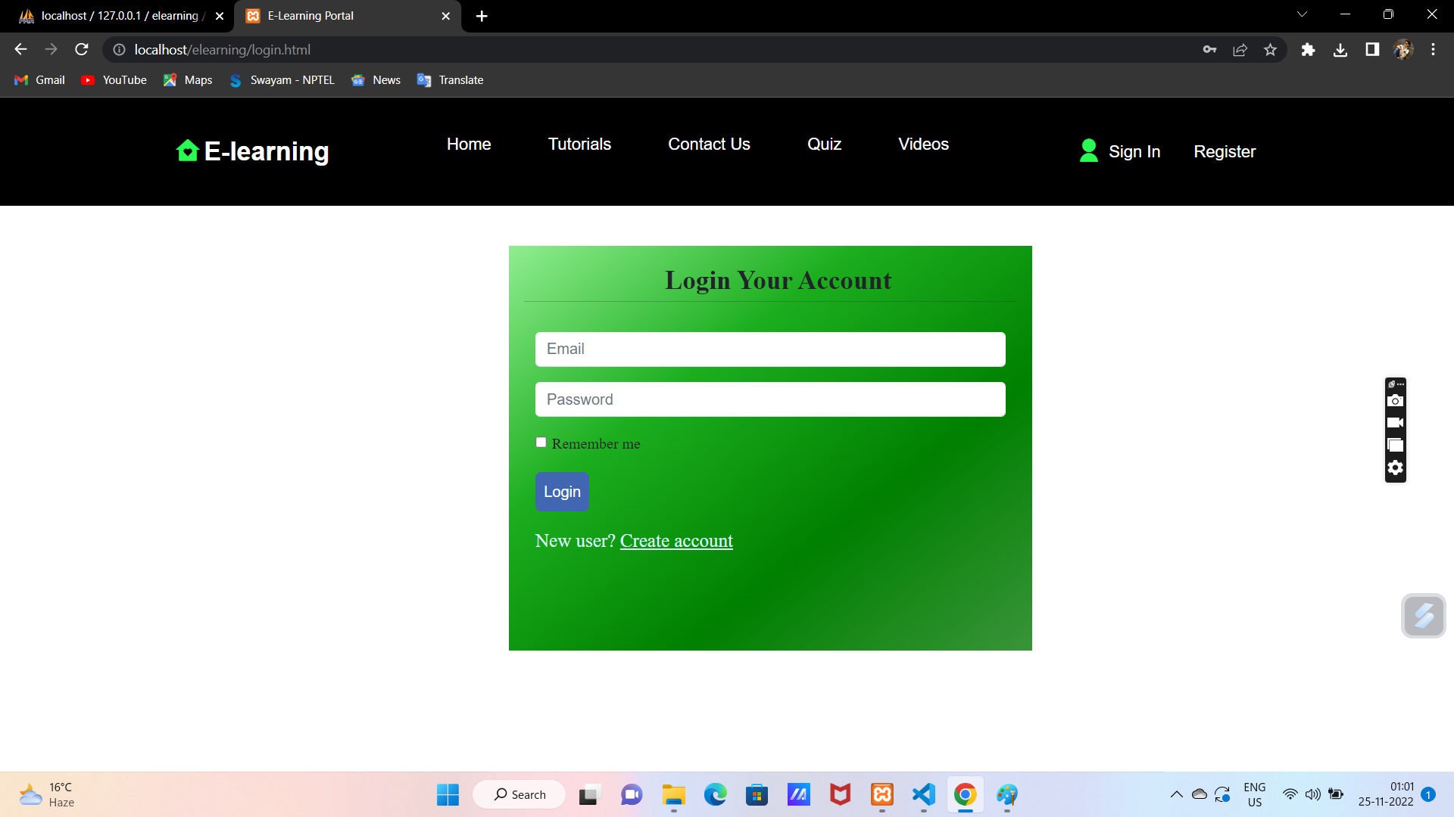

Slide 13
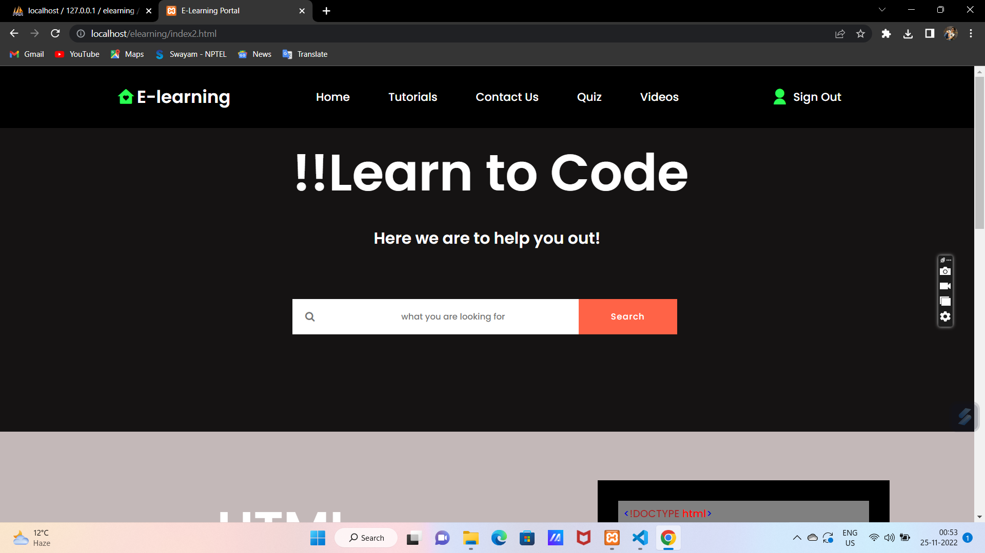
Home Page (after login) :

Slide 14
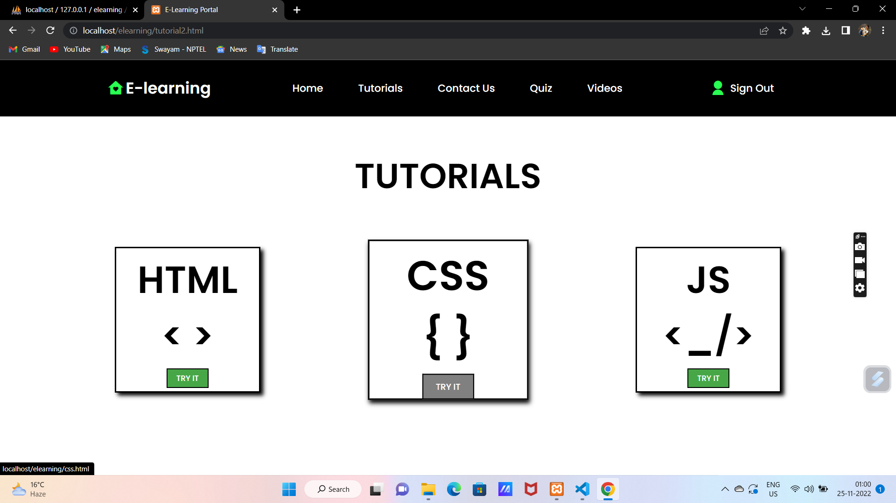
Tutorials Page :

Slide 15
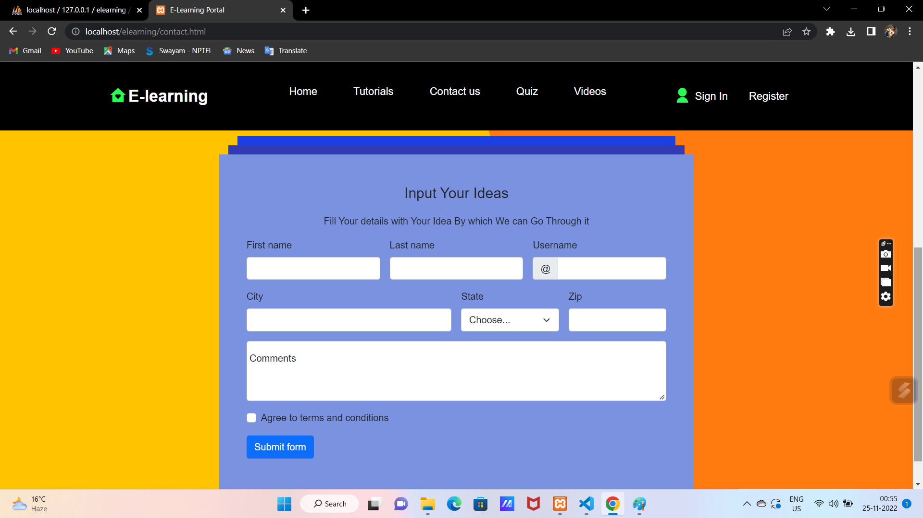
Contact Us Page :

Slide 16
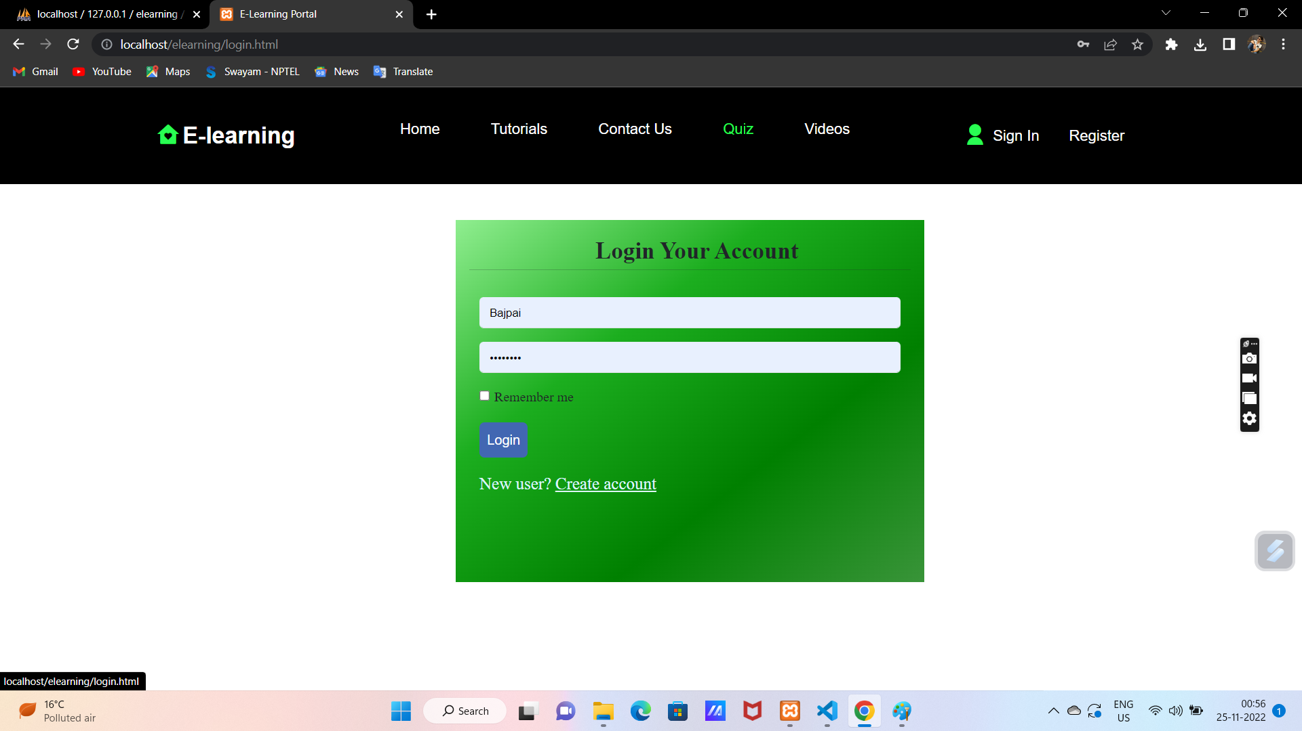
QUIZ PAGE (before login) :

Slide 17
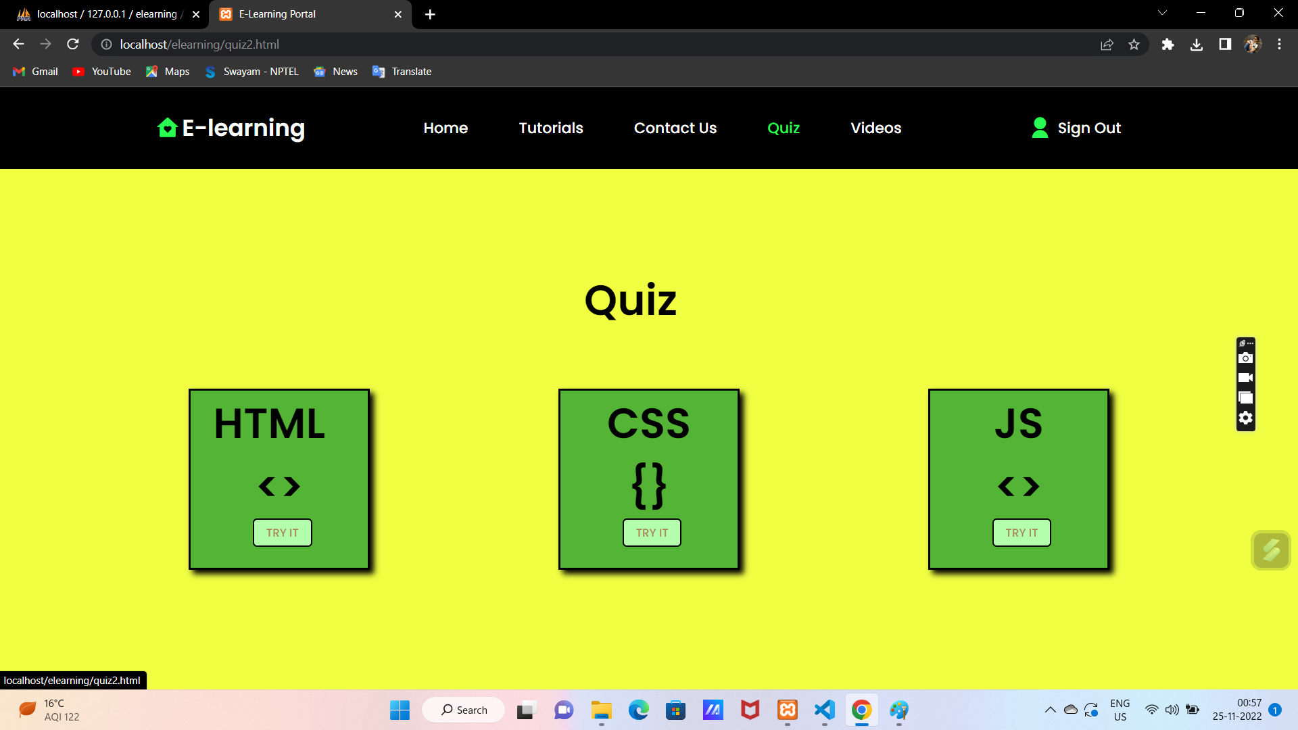
QUIZ PAGE (after login) :

Slide 18
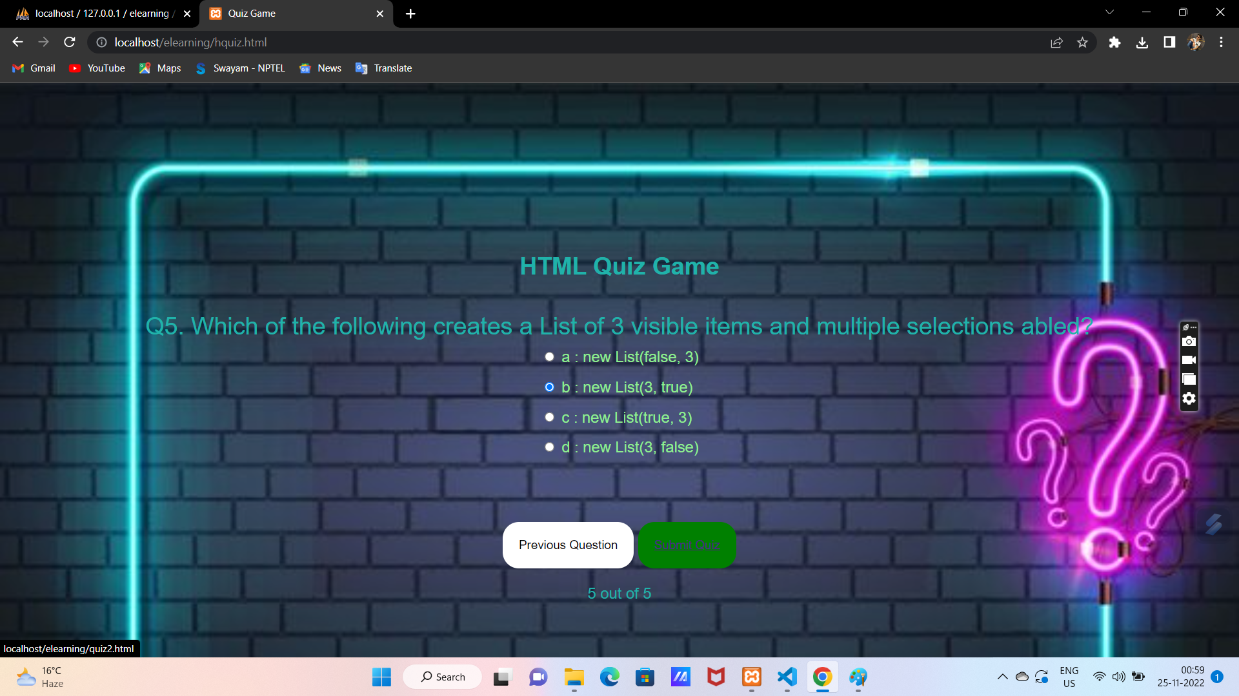
Quiz Interface:

Slide 19
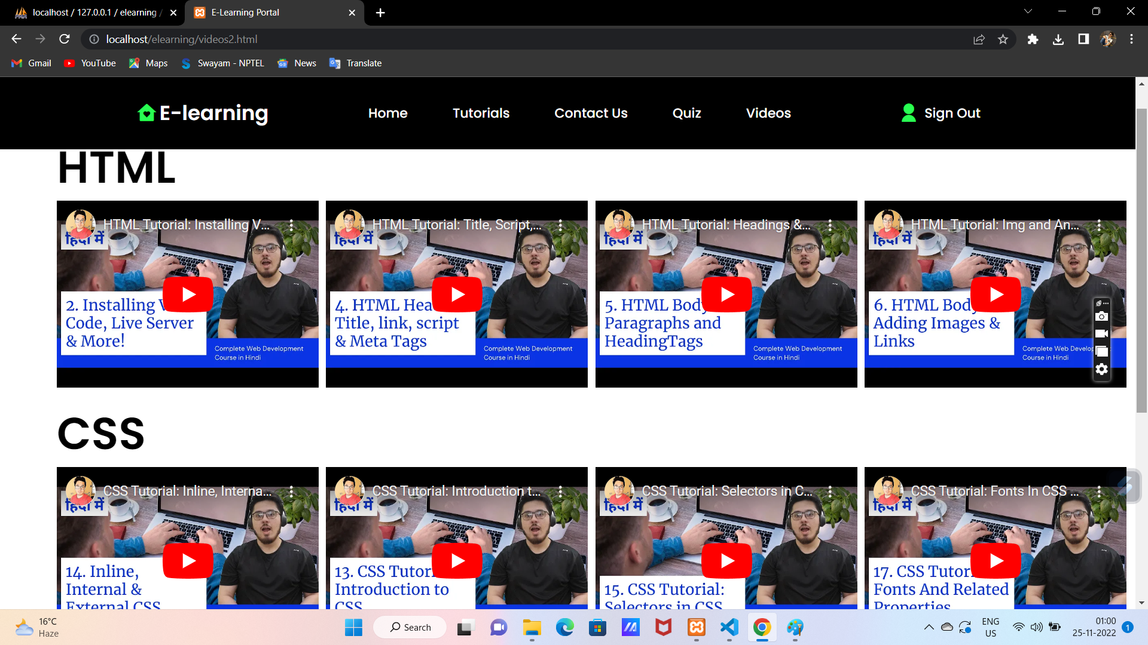
VIDEOS PAGE :

Slide 20
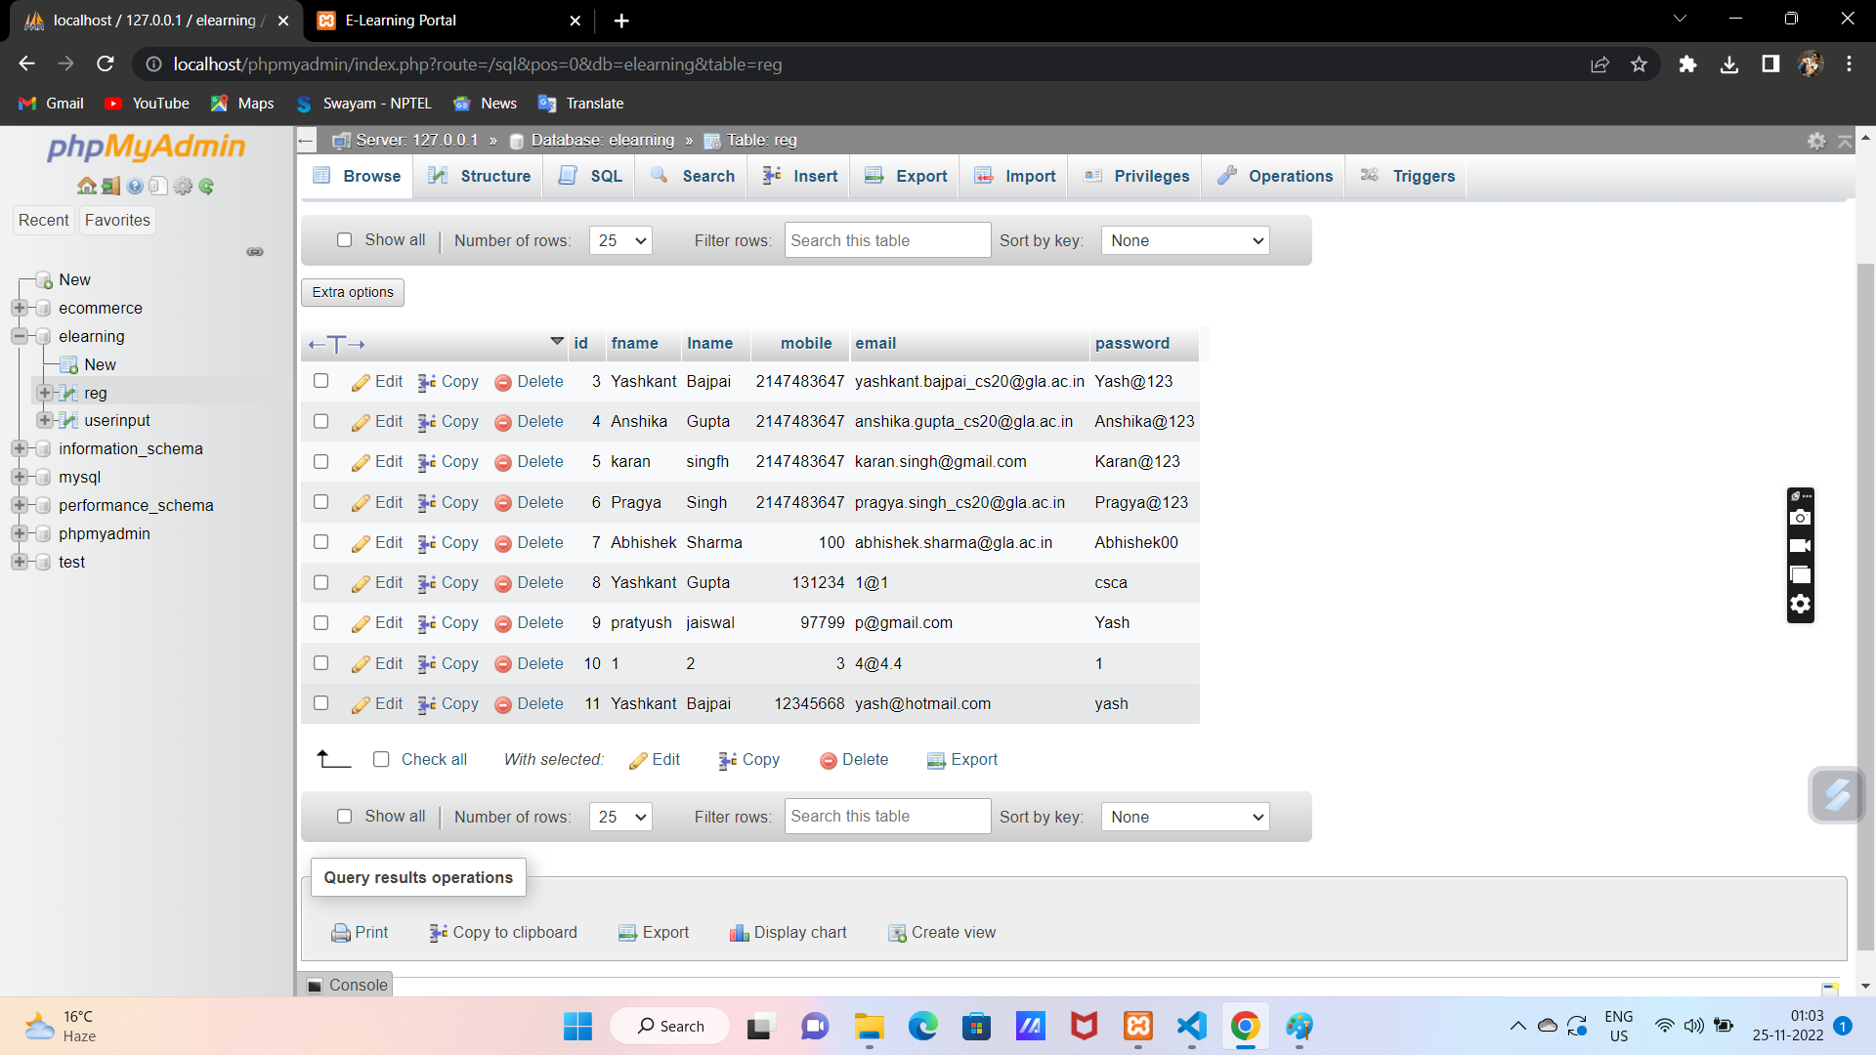
Database Visualization : 1. REG DATABASE :

Slide 21
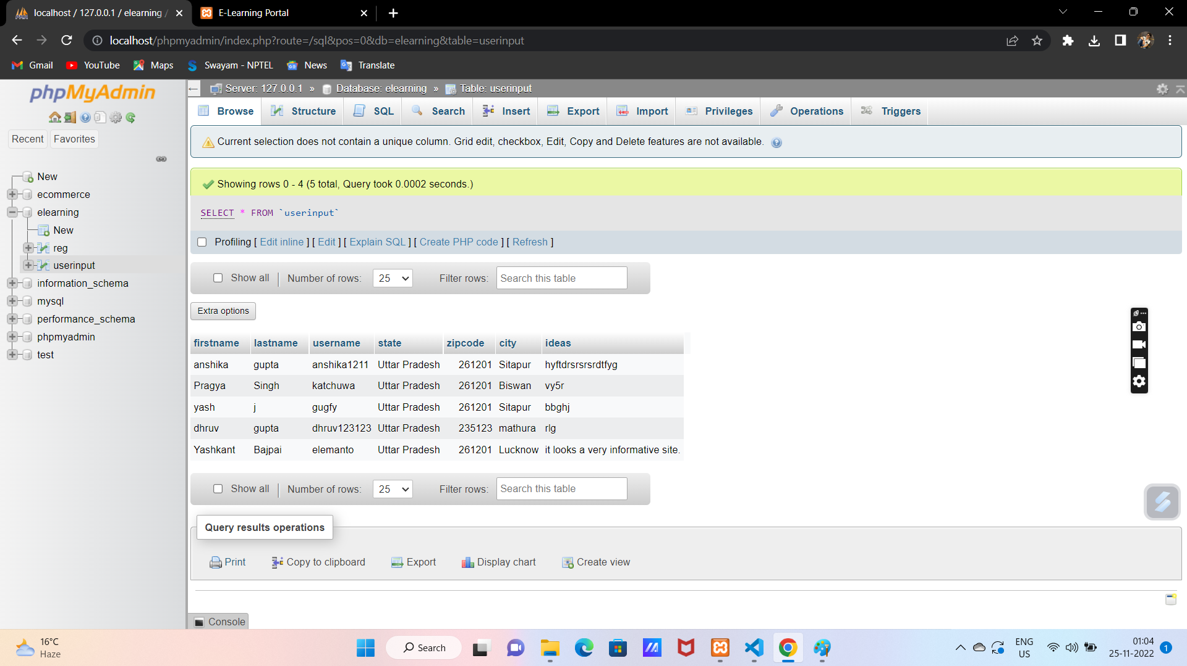
2. USERINPUT DATABASE :

Slide 22
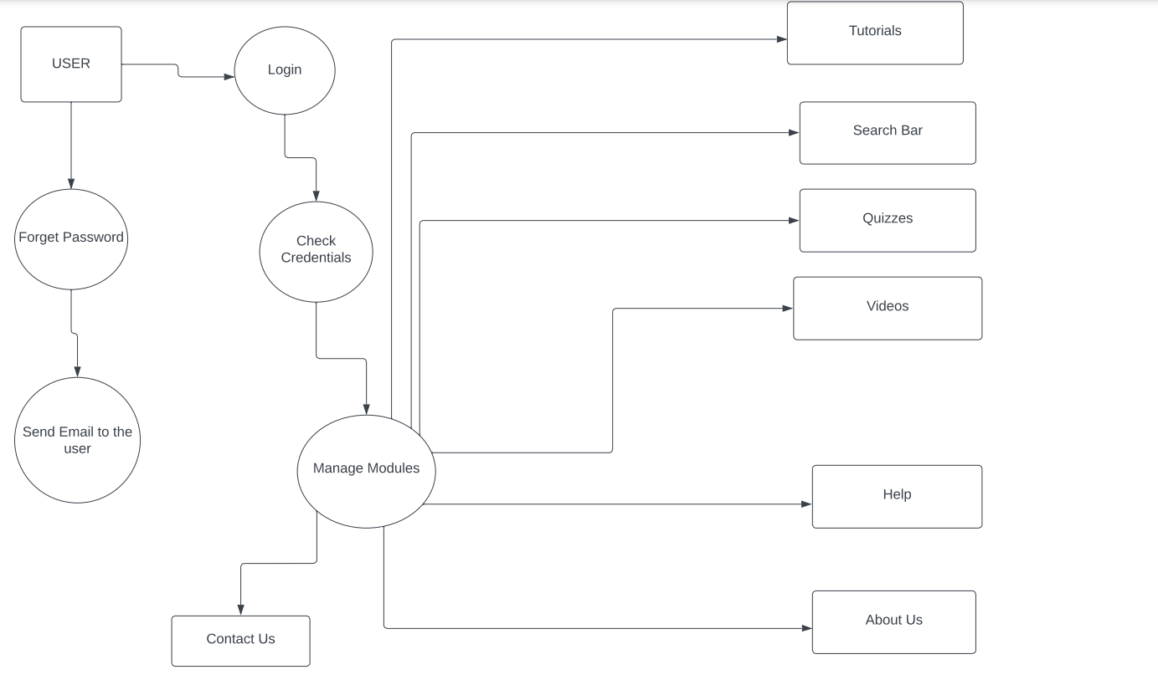
DFD

Slide 23
CONCLUSION AND SCOPE
There is always room for improvements in any software package, however good and efficient it may be. But the most important thing should be flexible to accept further modifications Right now we are just dealing with very few backend functionalities. In the future, this software may be extended to include features such as:
*Online Streaming: This will enable the user to take online lectures on the site having automatic attendance facility embedded.
*profile database and leaderboard: this will provide user a leaderboard ranking based on the attempted quiz and assessment marks available on their profile database.
It is well suited to propel the website into a sustainable application as per the tagline “Here, you can get the best content”.

Slide 24
THANK YOU

